Slide 1
Overview SAP - Production Planning(PP)

Slide 2
Introduction
Production Planning is the method of aligning demand with manufacturing resources to establish production and supply plans for finished goods and parts.
SAP PP is an important module. For example, it tracks and records the process the expected and real costs of the manufacturing process.
SAP Production Planning is one of the key modules in ERP and deals with planning processes, such as capacity planning, material planning, execution of production order, bill of material and goods movement. SAP PP module handles the master data required for Bill of Materials (BOMs) activity, work center and routing, and keeps it in a separate component.
It is fully compatible with SAP's other modules: SD, MM, QM, and FICO & PM.

Slide 3
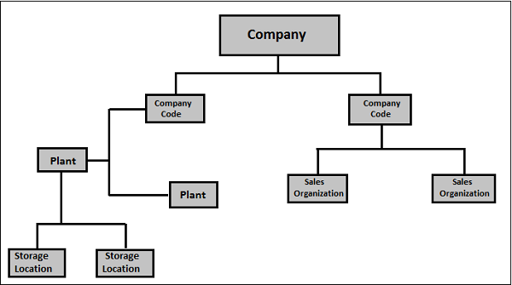
Organization Structure

Slide 4
Master Data
1. Material Master
2. Bill of Material (BOM)
3. Work Center
4. Routing
5. Production Version

Slide 5
Material Master
Production Planning Related Views in Material Master
MRP1 View
MRP2 View
MRP3 View
MRP4 View
Work Scheduling View

Slide 6
MRP1 View

Slide 7
MRP1 View
ABC indicator: This is an indicator showing the importance of the material in terms of stock availability.
Most of the companies use several ABC values, but most common are: A – the most important materials, they need to be available for sales in every moment customer requests it, B – less important materials that are often supposed to be available but the lack of this material can happen and is allowed, C – Least important materials. There can also be few more categories, N – new, material not yet tested on the market, so we don’t actually know if it’s going to be A, B or C yet. S – material that is produced only on customer request, and D – same as S with the difference that it has a certain quantity on stock just in case someone needs it ASAP, in production planning it is called a material safety stock.
MRP type: there are various types of MRP that can be utilized. In this case, our MRP controller signalled that it should be PD – default MRP for most of the SAP installations.
MRP controller: MRP controller responsible for production of this material, he manages all the data in these MRP views, along with the MRP results itself, production planning for this material etc. It is usual that the MRP controller provides the data for MRP views, or even in some organizational structures MRP controllers are maintaining these views on their own.
Lot size: defines the procedure used by the system in order to calculate the procurement or production quantity of the material.

Slide 8
MRP2 View

Slide 9
MRP2 View
Procurement type: here you can choose if your material has internal production (our case), external procurement, or both types of procurements are possible. It also mightn’t have procurement at all.
Production storage location: here you will maintain the storage location that is copied throughout the production documents. If this is a production component this marks the location from which the goods issue is posted, or if it’s produced material it annotates a location to which the material receipt is posted
Goods Receipt Processing Time in Days: you can set up this value that represents needed time in days for goods to be inspected and placed into appropriate storage location.
Schedule margin key: this represents a key used for determination of the floats required for scheduling an order. It is defined in customizing and is supplied by your MRP controllor or PP administrator.

Slide 10
MRP3 View

Slide 11
MRP3 View
Period indicator: indicates if material is to be planned/forecast monthly, weekly, yearly, daily etc. This is in most cases set to monthly.
Strategy group: used for grouping the planning strategies, for example, this can be set to Make to Order, Make to Stock etc. There are a number of options, and this must be defined by the production planning management. In most cases, material types and/or material ABC classification influences the decision which strategy group material should be assigned.
Consumption mode: this controls how system will consume requirements. In backward mode sales, orders, dependent
requirements or material reservations consume planned independent requirements that lie before the requirements date while in forward mode they consume planned independent requirements that lie after the requirements date.
Forward consumption period: number of day used as a consumption threshold in forward consumption mode. Can be set from 1 to 999 days but usually not longer than several days. We are using 0 since we are utilizing backward consumption mode for this material.
Backward consumption period: Same as previous except it is used for backward consumption mode.
Mixed MRP: defines if material is available for subassembly planning and gross requirements planning.
Mixed MRP: defines if material is available for subassembly planning and gross requirements planning.

Slide 12
MRP4 View

Slide 13
MRP4 View
Selection method: if you are using BOMs (Bill Of Materials) for your production, you could govern with the selection of alternative BOMs with this field. You can set selection type by order quantity, production version, explosion date.
Discontinued indicator: you can select the indicator for discontinued part as per requirements.
SLoc MRP indicator: this is the most powerful indicator on this view. It tells us if our storage location (that we used in organizational levels screen – in this example 0001 – Lager 0001) is relevant for MRP.

Slide 14
Work Scheduling View

Slide 15
Work Scheduling View
Production schedule profile: define how the process will flow in PP or PP-PI, some additional controls about automatic goods receipt etc. Customized by your PP consultant.
Underdelivery tolerance: define allowed percentage of quantity to be underdelivered.
Overdelivery tolerance: allowed percentage for quantity exceding for production or process order. For overdelivering, you can check the unlimited box – in that case we are allowing unlimited over delivery.
Setup time: time needed to setup and teardown work center resources (lot size independent).
Processing time: processing time for the base quantity.
Base quantity: used for processing and inhouse production time.

Slide 16
Bill of Material (BOM)
The material bill is a complete, formally organized list of the components and the quantity needed for creating or assembling the product.
BOMs are used in the planning and costing of material specifications.
You can build up to 99 alternate BOMs for a single commodity as well.
For goods with variants, you can build Super BOM, which has all possible components used to manufacture various types of variants. The suitable component is selected based on the characteristics chosen in the order of sale.
For example, all types of frames (with different colors and sizes) can be used in the Product Cycle, and the desired frame is selected by order of production on the basis of the color and size chosen in the order of sale.

Slide 17
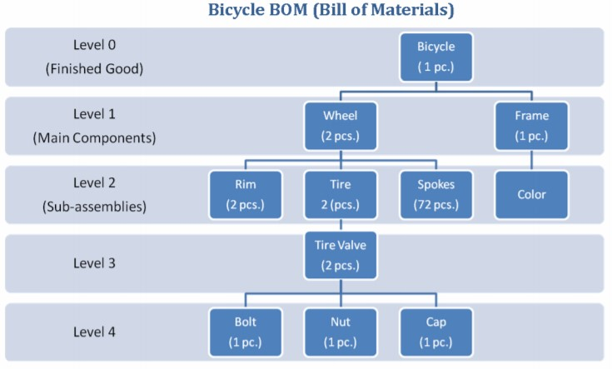
Bill Of Material (BOM)

Slide 18
Work Center
A Work Center is a system or collection of machines in which manufacturing processes are performed. Job center are included in the worklist events (Routings).
It provides the details for:
Scheduling
Capacity
Costing

Slide 19
Routing
Routing is nothing but a sequence of operation performed at the Work Center. It also specifies the machine time, labor time, etc. for the execution of operations.
It is also used for scheduling of operations and used in standard cost calculation of the product.

Slide 20
Production Version
The production version is a combination of BOM and Routing data for production. It is a linkage between BOM & Routing and determines the manufacturing process.
There can be multiple production versions as per different manufacturing process to produce the product.

Slide 21
Master Data Tcodes
Tcode | Description
MM01 | Create Material
MM02 | Change Material
MM03 | Display Material
CS01 | Create BOM
CS02 | Change BOM
CS03 | Display BOM.
CS11 | Explode BOM level by level single and multi level
CS12 | Explode multi-level BOM
CS13 | Display summarized BOM
CS03 | Display single-level BOM
CR01 | Create Work Center
CR02 | Change Work Center
CR03 | Display Work Center
CR05 | Work Center List
CA01 | Create Routing
CA02 | Change Routing
CA03 | Display Routing
C223 | Mass Production Version Creation

Slide 22
Demand Management
Demand Management's role is to forecast amounts of demand and distribution dates for finished goods and essential assemblies. PIR (planned autonomous requirements) and consumer requirements are used in Market Management.
Planning methods for a commodity must be established. It reflects the methods of development for planning and output. We have two ways to do this.
Make to Stock: The manufacturing of goods without orders for sale, i.e. storage, is carried out independently of orders.
Make to Order: This technique refers to the manufacturing of material for a particular individual order or line object.

Slide 23
Production Planning Cycle
Production Planning and Control consists of Two Phases
1. Planning
Generally, development planning is carried out using a budgeted revenue schedule. According to the production cycle periods, preparation is based on the Sales Schedule to fulfill the sales demands. In the type of expected independent need, demand for the commodity is entered by demand management (PIR). This demand management data becomes the input to Commodity Requirement Preparation (MRP). Using the master data such as Bill of Material (BOM) and usable existing plant stocks, MRP tests for the supply of various raw materials required for manufacturing at different times.
In supply shortages, procurement specifications are produced for commercially procured products and expected orders are created for in-house assembled materials.
These purchase requisitions and planned orders will initiate the procurement cycle and the production cycle.
Since MRP works with infinite capabilities, to avoid any capacity bottlenecks, capacity leveling must be done.

Slide 24
Production Planning Cycle
2. Execution
These planned orders are translated to production orders and scheduled as per the production timings using master data such as routings.
Production orders are issued on the shop floor by the Production Supervisor, and material availability checks can also be performed to check whether any missing components are present.
Output is carried out on the basis of routing activities where master data is identified against each routing activity, such as the Work Center.
If the product has been completed, the order confirmations are carried out, and products for material use and receipt of goods are put against the order. The order is then given the status of Delivered (DLV), and the material is received at the desired place of storage.

Slide 25
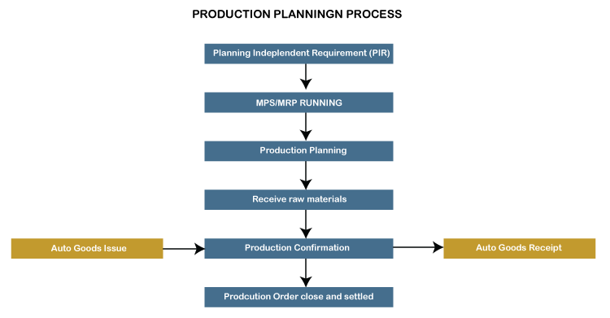
Production Planning Cycle

Slide 26
Planned Independent Requirement (PIR)
Planned Independent Requirements (PIR) are used to perform Demand Management functions.
A Planned Independent Requirement contains one planned quantity and one date for a material, or one planned quantity split over time according to dates.
PIR version “00” has an active indicator, which specifies that requirements would be considered in Material Requirement Planning (MRP).
If you want to maintain a number of versions of planned independent requirements, but do not want to include all versions in the material requirement planning run, you can set some versions to active and others to inactive, which could be used for simulations in Long term Planning.
PIR’s are associated with requirement type which is driven from planning strategies in the material master, which determines methods of planning – Make to Stock or Make to Order.
PIR’s are displayed in stock requirement list so that Planner can see and plan the production based on it.
PIR’s are generally used in Make to stock environment where business wants to build the stock based on the forecast and not on sales orders.

Slide 27
Make-to-Stock Planning Strategy
This is a planning strategy where the stock is produced without sales order. It is used to meet the customer demands in future.
Planning strategy 10: only PIR quantity is considered for MRP run and sales order is completely ignored. In this PIR, the requirement type is LSF and is reduced when you deliver stock to the customer.
Planning strategy 40: for MRP run a maximum of 2 PIR and Sales order can be considered, and PIR is reduced when you enter the Sales order. In this case, the requirement type is VSF.

Slide 28
Make-to-Order Planning Strategy
In this planning strategy, the finished products are not produced until you receive the sales order from a customer. For MRP run, you only consider Sales order.
In MTO strategy, you only produce sales order, stock and products are delivered as per sales orders from a specific customer.
Planning strategy 20 : MTO process
Planning strategy 25 : is used to produce product variants when there is a request for variant products from the customer.

Slide 29
Material Requirement Planning (MRP)
MRP run or planning run is an engine which is used to fill the demand and supply gap. Issues and Receipts are called MRP Elements. Issues include PIRs, dependent requirements, order reservations, sales orders, issuing stock transfer orders, etc. Receipts include production orders, purchase requisitions, purchase orders, open production orders,receiving stock transfer order, schedule lines,etc.
MRP Parameters
MRP parameters are required to run material requirement planning to meet PIR, and to use routing information.
Processing Key
1. NetChange − In this run system, consider those material which has undergone some changes from the previous MRP run.
2.NetChange in Planning Horizon − This run considers the requirement in predefined planning horizon and not like net change, which checks the future requirements. In this run, the system considers only those material which has undergone some changes from their last MRP run.
3.Regenerative Planning − In this run, the system considers all the materials irrespective of changes. It is time consuming and not common in Production planning.

Slide 30
Material Requirement Planning (MRP)
Scheduling
1. Basic Scheduling − It only calculates the basic dates for orders in MRP run and in-house production time for material master in use.
2. Lead Time Scheduling − In this MRP, production dates are defined by lead time scheduling for planned orders.
Planning Mode
1. Adapt planning data: It only processes the changed data.
2. Re explodes BOM and Routing: Read BOM and routing data again for the existing orders.
3. Delete and recreate planning data: It completely deletes the planning data (all receipts) and creates again.

Slide 31
Material Requirement Planning (MRP) - Tcodes
Tcodes | Description
MD01 | Total planning online
MDBT | Total planning in background
MD03 | Single-item, single-level planning
MD02 | Single-item, multi-level planning
MD43 | Interactive single-item planning
MD50 | Multi-level, make-to-order planning
MD51 | Multi-level project planning
MF52 | Display planning table
MF50 | Change planning table
MF57 | Planning table by MRP lists
MF51 | Planning table by production list

Slide 32
Master Production Scheduling (MPS)
You can use the MPS component (PP-MP-MPS) to flag materials, which greatly influence company profits or which take up critical resources, as master schedule items and to check and plan them separately with a series of special tools.
MPS is executed using the same principles as MRP. The aim of MPS is to reduce storage costs and to increase planning stability . This is useful in the following cases: To ensure that there is good material availability, various floats and a safety stock are entered, which inevitably lead to high stock levels .
Transaction Codes
MD41 - Single item multi level
MD42 - single level single item
MD43 - Interactive planning
MD40 - Total MPS run.

Slide 33
MRP Evaluation
Stock Requirement List: It is a dynamic list, which shows the current status of requirements & sources for that material. So any changes in the procurements or needs will be shown in this list.
MRP List: It is a static list, which shows the status of requirements & sources just after the MRP run. This list is not updated till the next MRP run.
Two lists helps the material planner to compare the changes which has taken place post MRP run. So comparing the 2 lists the planner can then make an informed decision whether the MRP run scheduling has to be done more frequently or whether it can be less frequent.
You can use Stock Overview to check the available stock of Material at any point of time.
Transaction Codes
MD04 - Stock Requirement List
MD05 - MRP List
MMBE - Stock Overview

Slide 34
Production Order
A production order is used to define the material to be produced, plant location where production has to be done, date and time of production, and quantity of goods required. A Production Order also defines which components and sequence of operations are to b used and how the order costs are to be settled.
BOM and routing data of the materials are copied into the production order, which determines the list of components and operational data in the order.
Following are the key steps involved in Production Order Execution
The first step is to convert a planned order to a production order. When you create a Production Order, type is defined in SAP PP system.
To start the production process, it is necessary to issue a Production order. Till a production order is not released, the execution of production process does not start.
Issuing goods is required for providing the goods to execute the Production order. Once goods are issued, the document number can be updated in the system.
All the sub processes are executed in accordance with the required operations to confirm the production as per the Production order.

Slide 35
Production Order
A Production Order can be created in the following ways.
From Planned Order Number
Manual Creation With Reference to Material
Transaction | Description
CO01 | Create Production Order(With Material)
CO02 | Change Production Order
CO03 | Display Production Order
CO05(N) | Release Production Order
CO08 | Create Production Order with Sales Order
MIGO | Goods Receipt/ Goods Issue/ Cancellation of Material Document
CO11(N) | Production Order Confirmation
CO15 | Production Order Confirmation
CO13 | Cancel Production Order Confirmation
CO16(N) | Reprocessing Confirmation
COGI | Automatic Goods Receipt: Error Handling
COHV | Mass Processing
CO46 | Collecitive Conversion( Planned Order)
MD16 | Planned Order Conversion
COOIS | Production Order Information System

Slide 36
Capacity Planning
Capacity planning is done to balance the load at the work center. You can calculate the production capacity based on the requirement of the product as per the available capacity.
Capacity leveling takes place for detailed production planning purpose. This is done through a planning table used for detailed planning of capacity requirements over time in future.
You need to check the capacity load on the work center. If any work center is overloaded, we need to move orders to different work centers.
CM01 - Capacity Planning
CM21 - Capacity Levelling

Slide 37
Integration With Other Modules
SAP PP and SAP MM
This involves movement of goods, auto goods receipt.
It includes creating a reservation for Production Order/Planning.
Raising purchase orders with MRP Run.
Quotations and Vendor selection.
SAP PP and SAP SD
This is used to check the availability of material for production order.
To perform MRP Run, Requirement Types.
Bill of Material components and operation.
SAP PP and Quality Management
Inspection Type 03 for discrete and repetitive manufacturing.
Inspection Type 04 for both discrete and repetitive manufacturing.

Slide 38
Integration With Other modules
SAP PP and SAP FICO
Updating price in material master data.
Defining activity type in the cost center.
Assigning activity type to work center.
Cost Estimation.
Production cost controlling
Posting accounting activities related to goods movement, material request, etc.
SAP PP and Project System
Assigning planning activities to WBS in the Project.
Running Material requirement planning at Project level (MD51). The procured material attached to WBS are reserved as project stock against the particular project.
The component attached to the network are planned at the plant level and are reserved as plant stock.

Slide 39
Manufacturing Process
Based on different nature of products and complexity, there are 3 types of manufacturing process followed in SAP PP.
Discrete Manufacturing
Repetitive Manufacturing
Process Manufacturing
Discrete Industry Manufacturing Process
In discrete scenario, the manufacturing process is based on production orders. Discrete manufacturing is characterized by requirements that occur on an irregular basis and a workshop-oriented process. Basically the demand and supply varies time to time in this scenario.
Discrete manufacturing forms an industry type where in the products which are manufactured can be easily assembled and dis-assembled. They can be reworked upon easily to a large extent. You can say making pumps, engines, cars, airplanes.

Slide 40
Repetitive manufacturing Process
Company manufactures product in large numbers and production is quantity based and period based not order based.You can use repetitive manufacturing as either make-to-stock REM or make-to-order REM such as in the automotive industry.
Repetitive manufacturing form an industry type where in the products manufactured can be discrete manufactured or process industry type, produced repetitively or continuously in production lines. This forms the continuous production scenario.
Process Industry Manufacturing Process
The component Production Planning for Process Industries (PP-PI) provides an integrated planning tool for batch-oriented process manufacturing.It is primarily designed for the chemical, pharmaceutical, food and beverage industries as well as the batch-oriented electronics industry.

Slide 41
Steps Discrete Manufacturing Process
Step 1: Material Master
Logistics > Production > Master Data > Material Master > Material > Create General > Immediately MM01
Step 2: BOM creation
Logistics > Production > Master Data > Bills of Material > Bills of Material > Material BOM > Create CS01
Step 3: Work Center creation
Logistics > Production > Master Data > Work Center > ( New Screen ) Work Center > Create CR01
Step 4: Route creation
Logistics > Production > Master Data > Routings > Routings > Routing > Create CA01
Step 5: PIR Generation
Logistics> Production>production planning>demand management>PIR>Create MD61
Step 6: MRP Run
Logistics>Materials Management>Material planning>MRP>MRP>Total Planning>Online MD01
or
Logistics > Production > MRP > MRP > Sng-Item, Multi-Level MD02
Step 7: Evaluation through MRP list and Stock requirement list
Logistics>Materials Management>Materials Planning>MRP>Evaluations>MRP List>Individual Display MD05
Logistics>Materials Management>Materials Planning>MRP>Evaluations>Stock Requirements List MD04

Slide 42
Steps Discrete Manufacturing Process
Step 8: Conversion of Planned order to Production order
Logistics > Production > Production control > Order > Create > With a planned order CO40
Logistics >Production > Production control >Order > Create >With material CO01(For creating production order Without planned order)
Step 9: Order management
Logistics >Production > Production control >Order > Change >With material CO02
Step10: Confirmations
Logistics >Production >Production control >Confirmation >Enter >For order CO15
or
Logistics >Production >Production control >Confirmation >Enter >For Operation >For time ticket CO11N
Step11: Goods issue
1. Logistics >Production >Production Control >Environment >Goods Movement >Goods Issue
2. Logistics >Materials Management >Inventory Management >Goods Movement >Goods Issue MB1A--261Movement type
Step12: Goods receipt
Logistics > Production > Production Order > Environment > Material Movement > Post Mat to Stock
or
Logistics > Materials Management > Inventory Management > Goods Movement > Good Receipt > For Order MB31
Step13: Techo Or Close Order.
This can be done from Prd. Order Header menu.

Slide 43

SAP Prouction Planning (PP) Overview Session

